Slide 1




EXCELSSIOR EDUCATION SOCIETY’S K. C. COLLEGE OF ENGINEERING AND MANAGEMENT STUDIES AND RESEARCH (Affiliated to the University of Mumbai) Mith Bunder Road, Near Hume Pipe, Kopari, Thane(E)-400603
Department of Computer Engineering
Academic Year 2023-24(Odd Semester)

Slide 2
Index
Introduction to Topic
Need of Project
Problem Statement
Literature survey In Tabular Format
Algorithm for Project Development
Block Diagram
Flow-chart
Requirement Hardware and Software
Feasibility Study
Proposed Methodology
Detail Design DFD Diagram
Activity Diagram
Screenshots of GUI
References

Slide 3
Introduction to Topic
In the TicTacToe Game Application players take turns marking empty spaces with their symbols, "X" and "O," with the goal of forming a line of three of their symbols in a row, either horizontally, vertically, or diagonally, before their opponent does. It's a simple yet engaging game that teaches basic strategy and decision-making.
Tic-Tac-Toe is enjoyed by people of all ages and is both a fun pastime and a valuable tool for introducing gaming concepts to beginners.

Slide 4
Need of Project
Tic Tac Toe, a classic two-player game, has captivated the minds of players young and old for generations. This abstract introduces a modern and innovative perspective on the game by integrating artificial intelligence (AI) algorithms to enhance gameplay and strategy.
This game focuses on the development of a Tic Tac Toe game that incorporates AI-based decision-making, providing players with challenging opponents that adapt and evolve their strategies over time. The implementation of the Minimax algorithm, coupled with the Alpha-Beta Pruning technique, ensures an optimal and efficient gameplay experience. Additionally, a user-friendly graphical interface is designed to facilitate an enjoyable and intuitive gaming experience.
Furthermore, this study explores the significance of AI in enhancing traditional board games like Tic Tac Toe, providing insights into how technology can revitalize and redefine classic pastimes. By merging strategy and AI, this project aims to reignite interest in this timeless game, catering to the preferences of both casual players and enthusiasts alike.
Overall, this research contributes to the field of gaming by showcasing the potential of AI integration in transforming the gaming experience, offering a fresh and challenging take on the beloved Tic Tac Toe game.

Slide 5
Problem Statement
Modernizing Tic Tac Toe: The project seeks to modernize the classic game of Tic Tac Toe, indicating the intent to enhance and update the traditional game.
Offline 1-Player Option: The primary goal is to provide a 1-player option that allows users to play offline against a computer opponent. This feature is designed for relaxation and enjoyment when internet access or a human opponent is unavailable.
User Convenience: The project aims to improve user convenience and accessibility by offering an offline gaming option, thereby addressing the needs of users looking for a solo gaming experience.
Preserving the Classic Game: While introducing modern elements, the project maintains the fundamental essence of Tic Tac Toe, ensuring it remains recognizable to users.
Adapting to Changing User Preferences: The initiative acknowledges the evolving preferences of users who seek digital solutions for traditional games, enhancing their gaming experience.
Combining Tradition and Technology: By integrating technology (offline 1-player mode) with a classic game, the project blends the charm of the original game with the advantages of modernization.

Slide 6
Literature survey In Tabular Format
Year | Associated Person/People | State of the Game
Prehistoric | Unknown | Informal variations played with stones or marks on the ground
1952 | Alexander S. Douglas | First computer based Tic-Tac-Toe AI,”OXO” on EDSAC
1958 | Christopher Strachey | First Graphical computer version of Tic-Tac-Toe
1990 | David Levy | Study on Tic-Tac-Toe’s Game Complexity and Strategy
2000 | Various Mathematicians and Game Theorists | Established optimal strategy for Tic-Tac-Toe
2010 | Tic-Tac-Toe enthusiasts and Researchers | Various game variants and deeper analysis
2020 | Researchers and AI developers | AI agents achieving superhuman level of play
2030+ | Ongoing Research by various Experts | Potential future developments such as quantum computing and virtual reality integration

Slide 7
Algorithm for Project Development
Project Initiation:
Define project objectives: Create a mobile Tic Tac Toe game for 1 and 2 players.
Identify stakeholders and establish communication channels.
Assess resource and timeline feasibility.
Planning and Design:
Design the game architecture with components for 1 and 2 player modes.
Decide on the technology stack for mobile app development.
Design user interfaces with basic animations to enhance user experience.
Development:
Build the mobile app, implementing game logic, UI, and animations.
Code 1-player mode with AI opponent using algorithms like Minimax.
Implement 2-player mode for local multiplayer.
Testing:
Test the app for functionality, user-friendliness, and performance.
Address and fix any identified issues.

Slide 8
Algorithm for Project Development
5. User Testing:
Conduct beta testing with a small group to gather user feedback.
Make improvements based on user suggestions.
6. Deployment:
Deploy the app to app stores and ensure compatibility with various devices and OS versions.
7.Documentation:
Document app architecture, design decisions, and key features.
Create user instructions for playing the game.
8.Project Closure:
Verify project completion and compliance with standards.
Archive project data and records.
Obtain formal stakeholder approval for closure.
9.Post-Project Review:
Evaluate project performance against objectives and KPIs.
Identify areas for improvement and lessons learned.

Slide 9
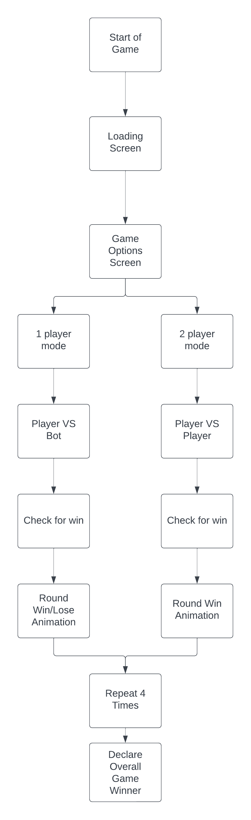
Block Diagram/ Architecture

Slide 10
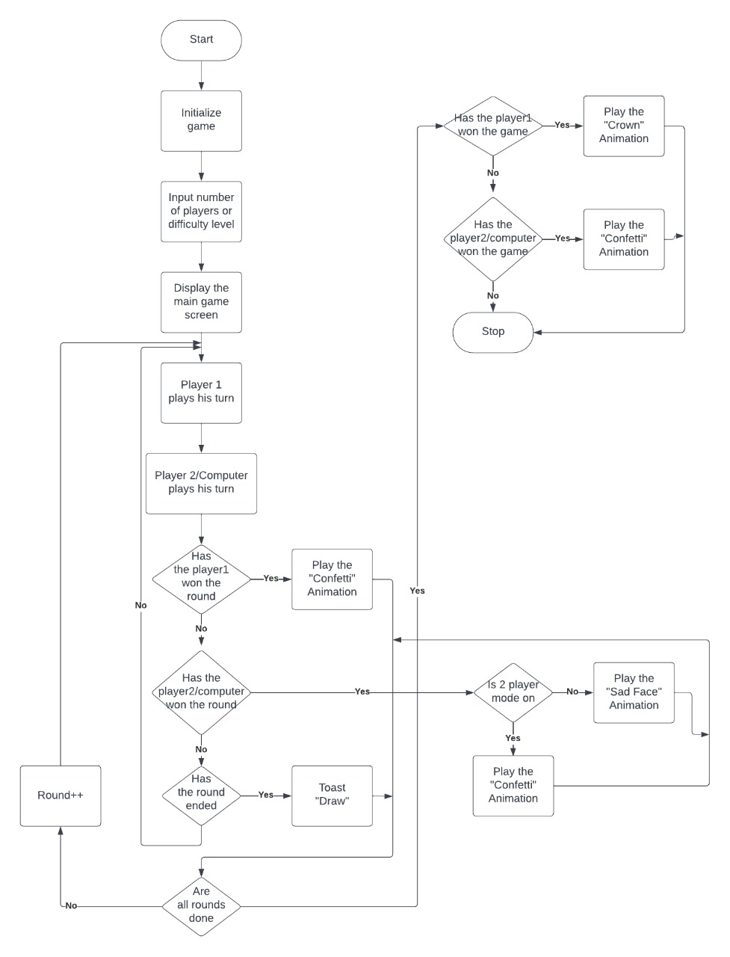
Flow-chart

Slide 11
Requirement Hardware and Software
Hardware :-
Minimum Requirements:
Processor:- Dual core processor @2.4Ghz
Ram:- 4GB Ram
Storage:- 2GB free space
Recommended Requirements:
Processor:- Quad core processor @2.8Ghz
Ram:- 8GB Ram
Storage:- 4GB free space
Software :-
Minimum Requirements:
API: API Level 30- Android 11
Recommended Requirements:
API: API Level 34- Android 14

Slide 12
Feasibility Study
Technical Feasibility:
The project can be technically implemented with readily available development tools and expertise.
Animation and AI algorithms for 1-player mode can be effectively integrated.
2. Economic Feasibility:
Development costs are manageable within the allocated budget.
Revenue projections suggest a positive ROI within a reasonable timeframe.
3. Operational Feasibility:
The project aligns with the organization's capabilities and resources.
Integration into existing operations is feasible.
4. Legal and Regulatory Feasibility:
No significant legal barriers are foreseen, and compliance with app store guidelines is ensured.
5. Scheduling and Time Feasibility:
Project timelines allow for timely development and deployment.

Slide 13
Proposed Methodology
Project Initiation:
Define the objectives and scope of the mobile Tic Tac Toe game project.
Identify stakeholders and establish communication channels.
Assess project feasibility, including resource availability and timeline constraints.
Planning and Design:
Develop a detailed project plan with milestones and deliverables.
Choose the technology stack for mobile app development.
Create the game design, including the user interface (UI) and basic animations.
Development:
Build the mobile app, implementing game logic, UI, and animations.
Code 1-player mode, incorporating AI algorithms for the opponent.
Implement 2-player mode for local multiplayer.

Slide 14
Proposed Methodology
4. Testing and Quality Assurance:
Conduct rigorous testing, including functionality, user-friendliness, and performance.
Address and resolve any identified issues or bugs.
5. User Testing:
Conduct user testing with a small group to gather feedback.
Make improvements based on user suggestions and usability testing.
6. Deployment and Distribution:
Deploy the app to app stores (e.g., Apple App Store, Google Play Store).
Ensure compatibility with various devices, screen sizes, and OS versions.
7. Documentation and User Guides:
Prepare documentation for the app's architecture, design decisions, and user instructions.
Include in-app help and instructions for playing the game.
8. Project Closure:
Verify that all project deliverables are complete and meet required standards.
Archive project data and records.
Obtain formal approval from stakeholders for project closure.

Slide 15
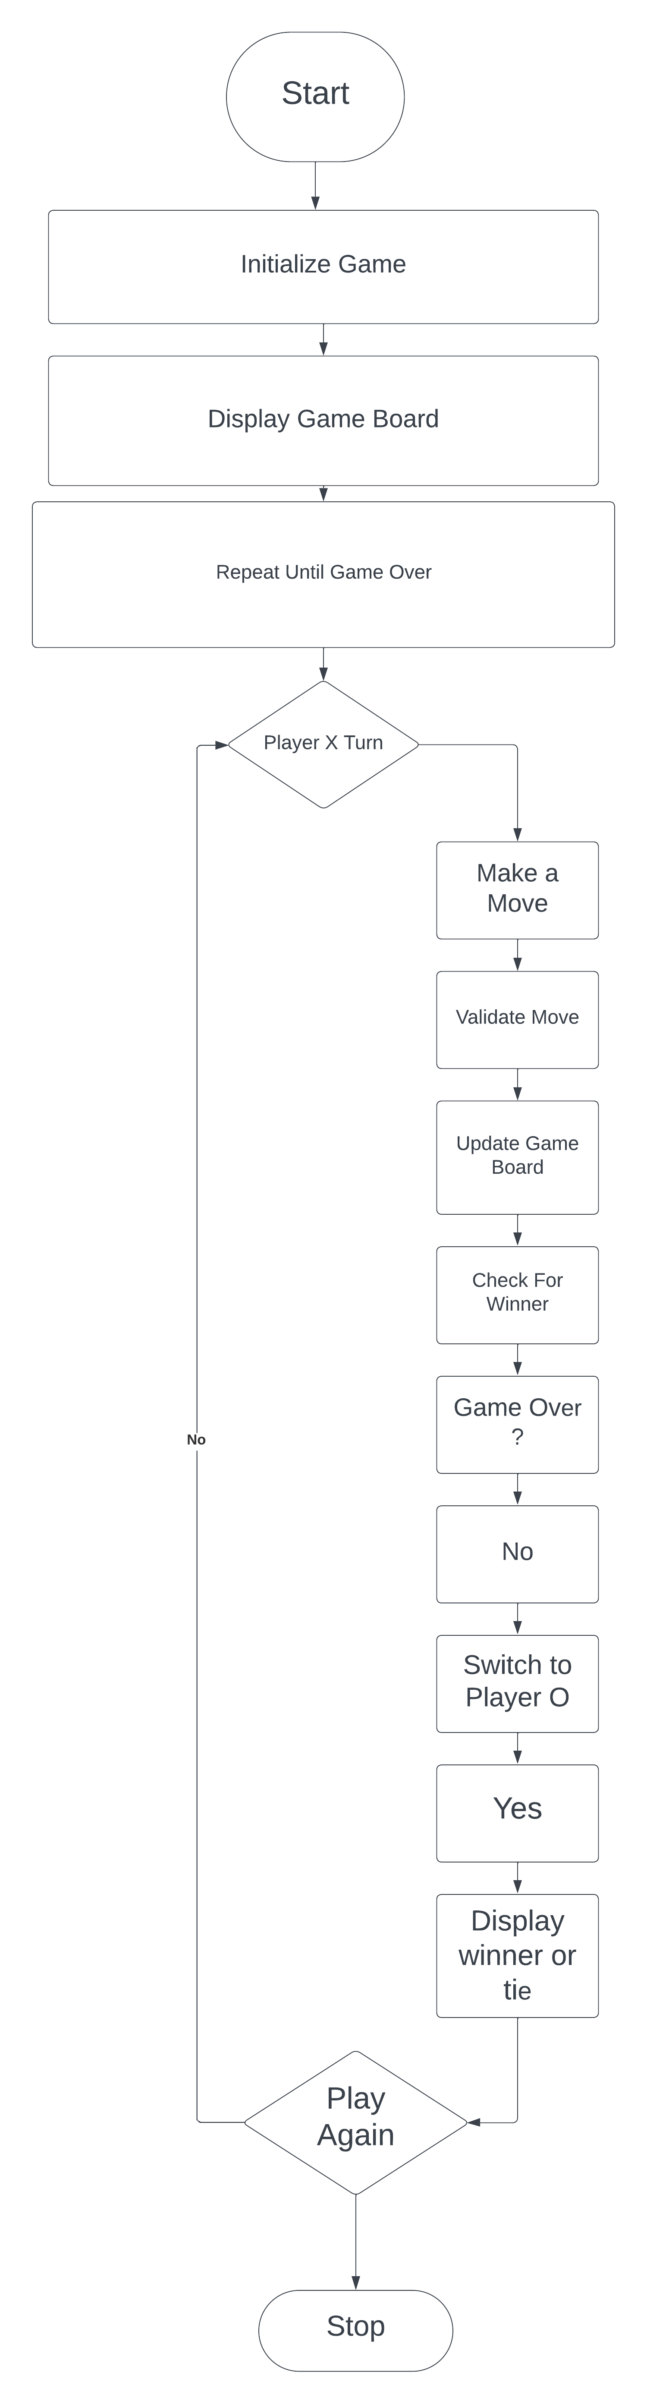
Detail Design DFD Diagram

Slide 16
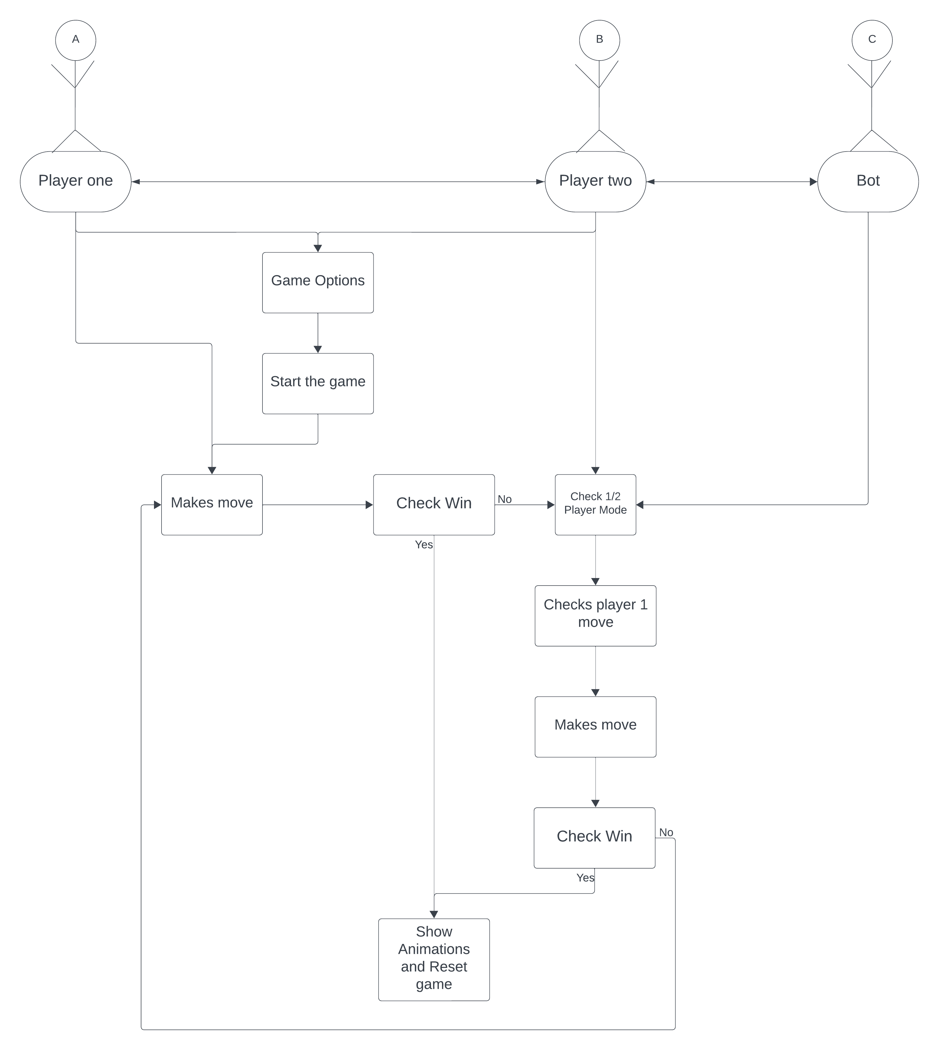
Activity Diagram

Slide 17
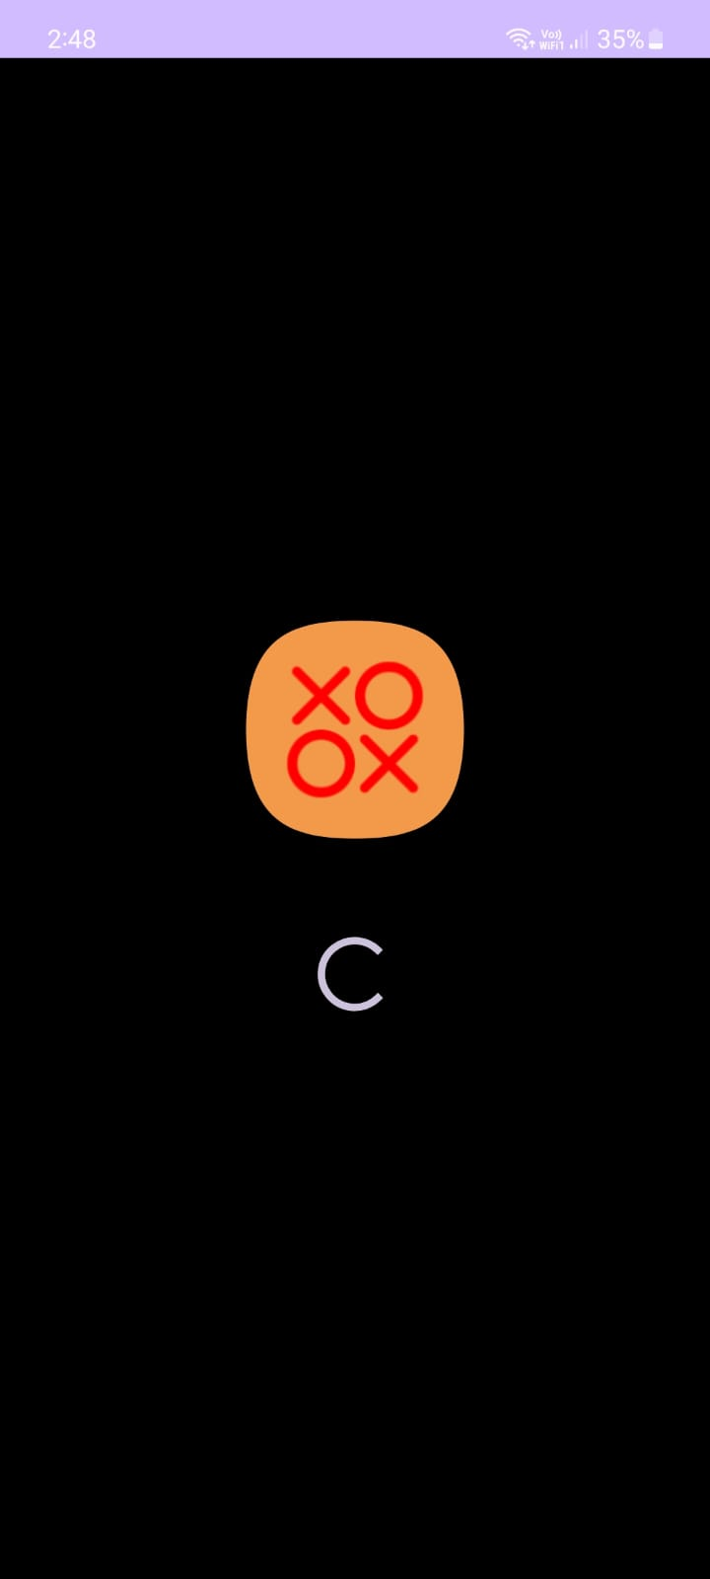
Implementation Details/ Screenshots of GUI
Loading screen:
The first Screen shown to the user when the application is opened, it consists of the Application logo and a Spinning progress bar
This screen is shown for a duration of 3 seconds after which the thread has completed and hands over the progress to the Game options Screen.
Figure 1

Slide 18
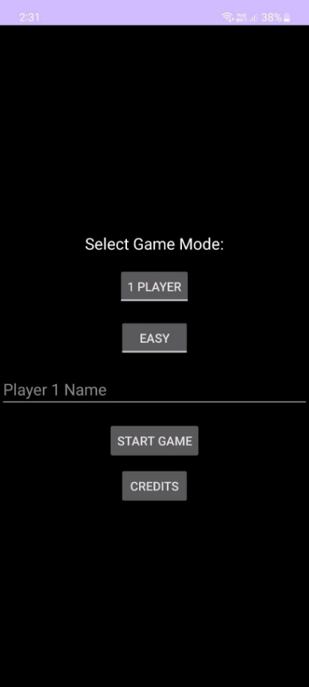
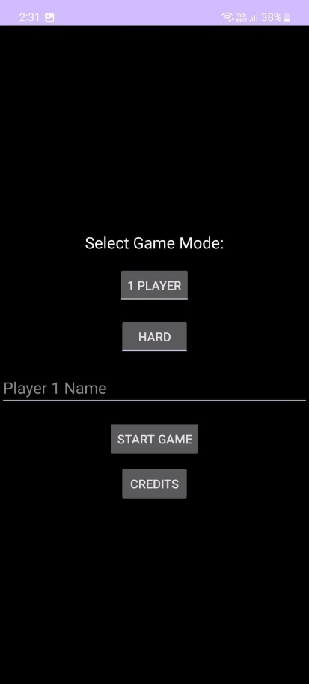
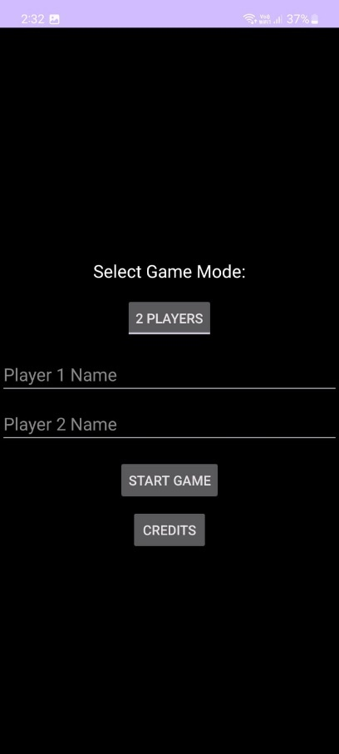
Game Options Screen:
Game Options Screen:
Figure 2,3,4- This is the Game options screen that comes up after the loading screen has ended.
Figure 2,3,4- From the top it has a toggle button consisting of 2 options, 1 player mode and 2 player mode.
Depending on the mode chosen by the user the following options below it change:
Figure 2,3-For 1 player mode, A second toggle button is visible, which has 2 options for the difficulty of the AI the user will play against, it has easy or hard mode to choose from.
Following which the text field for the name of player 1 is present.
Note: Player 2 name text field is hidden as it will default to BOT.
Figure 4- For 2 player mode, there are only 2 text fields visible for player 1 name and player 2 name.
Figure 2,3,4- After these options, there are consistent options of Start Game and the Credits button.
Figure 4
Figure 3
Figure 2

Slide 19
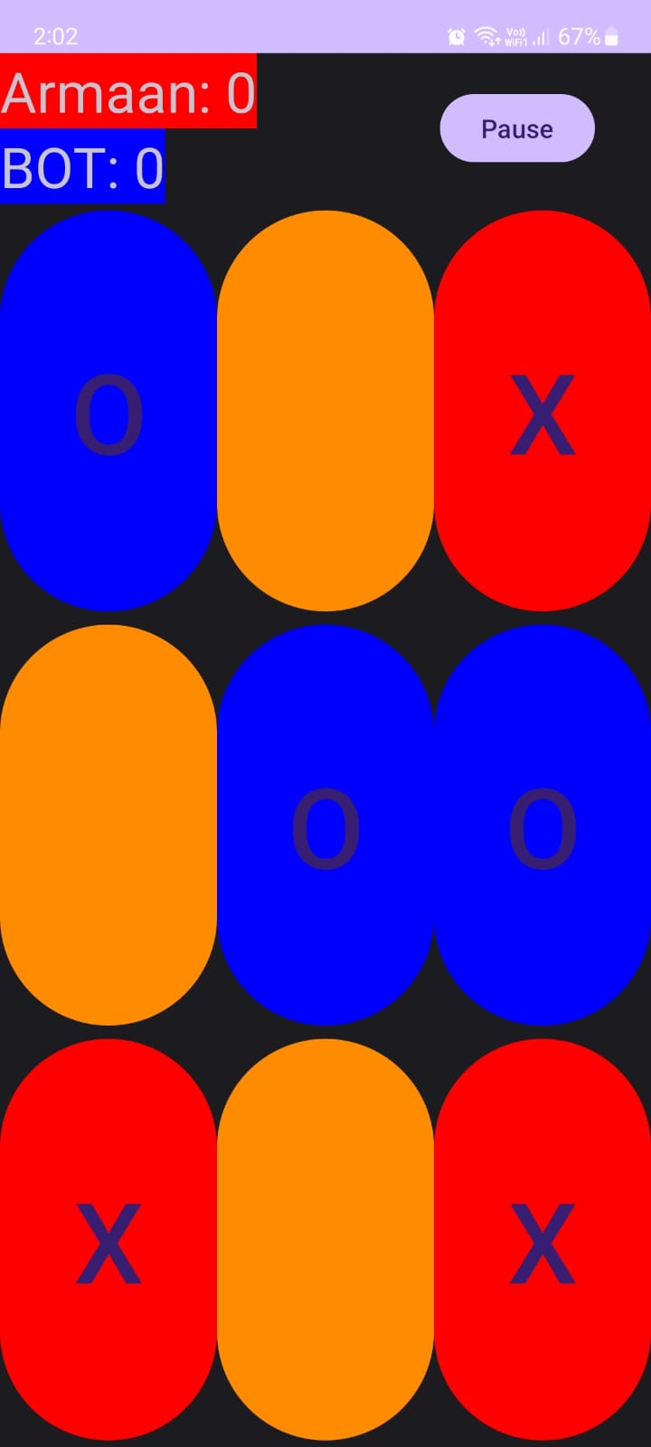
1 Player Game:
This is a screenshot of the session in progress having orange as the default button color, depending on X and O clicking on it, will change to Read or Blue respectively.
X is player 1 (as shown as the color of the box around the player’s name)
O is BOT (as shown as the color of the box around the player’s name)
Figure 5

Slide 20
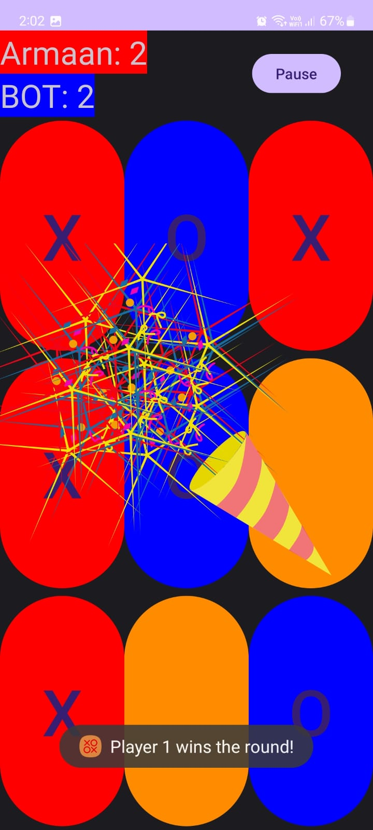
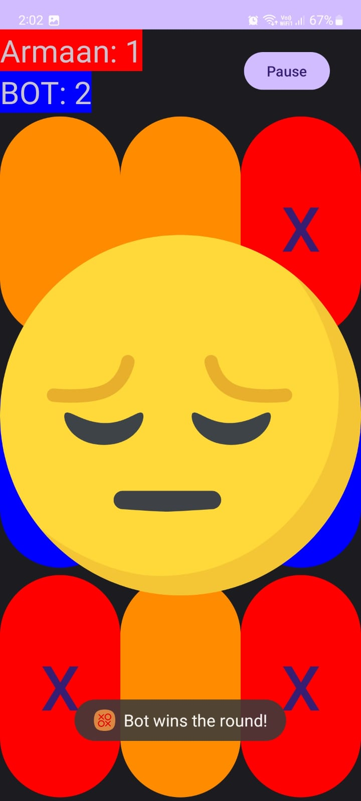
Winning Animations in 1 player mode:
Figure 6-Shows the animation and the toast that is displayed to the user when the user wins the round.
Figure 7-Shows the animation and toast that is displayed to the user when the BOT wins the round.
Figure 6
Figure 7

Slide 21
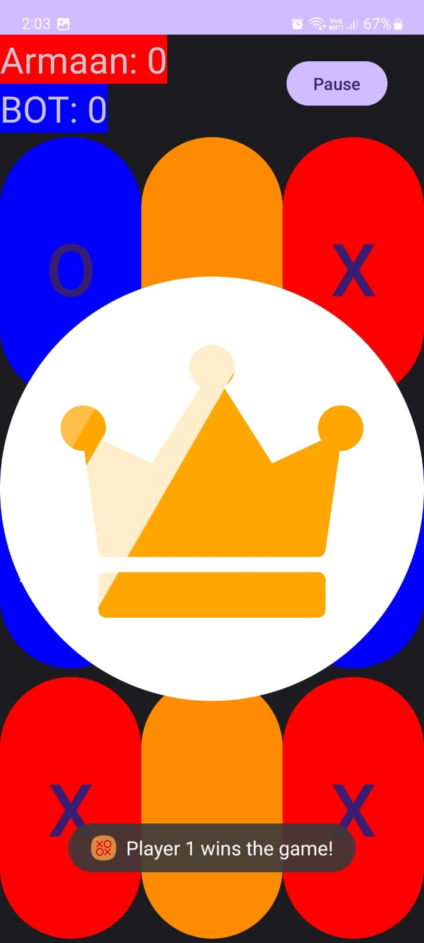
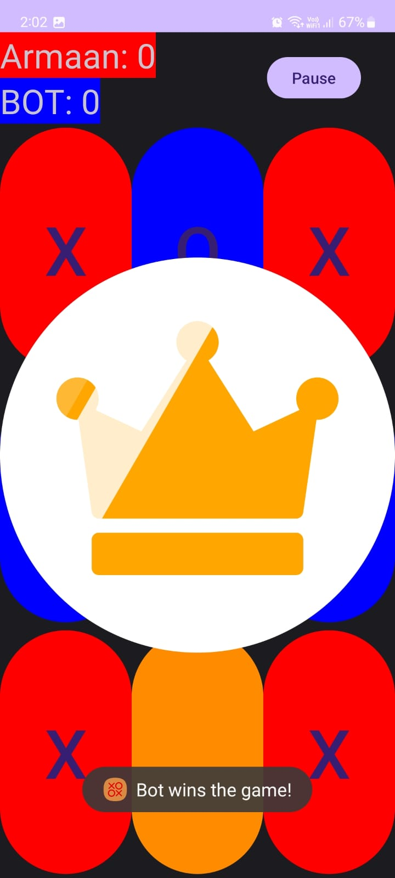
Figure 8- Shows the animation and the toast that is displayed to the user when then user wins the game.
Figure 9- Shows the animation and toast that is displayed to the user when the BOT wins the game.
Figure 9
Figure 8

Slide 22
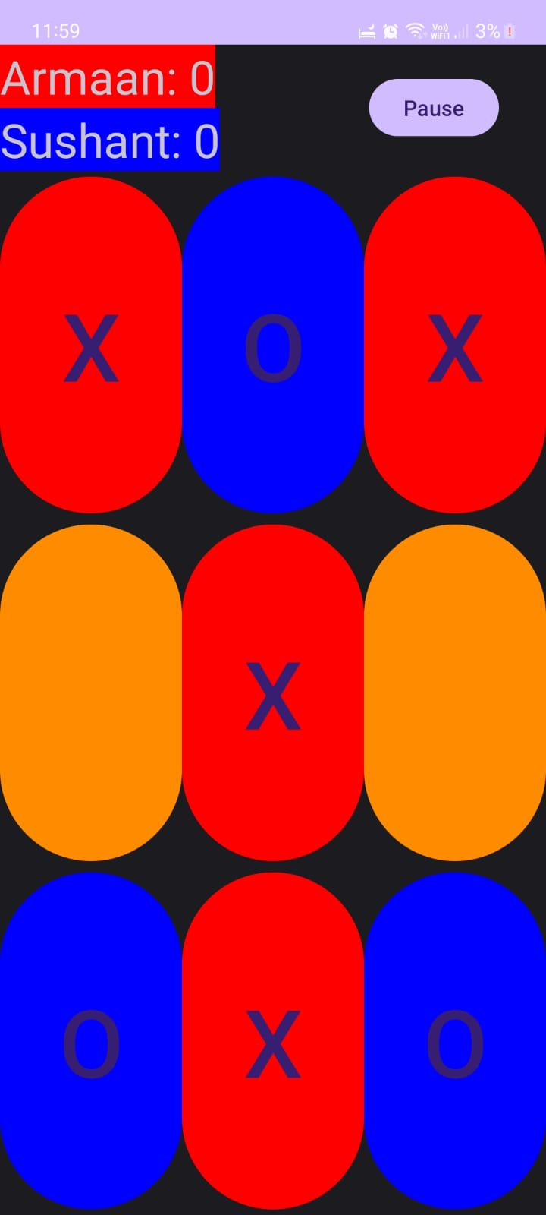
2 Player Game:
Figure 10-Is is a screenshot of the session in progress having orange as the default button color, depending on X and O clicking on it, will change to Read or Blue respectively.
X is Player 1 (as shown as the color of the box around the player’s name)
O is Player 2 (as shown as the color of the box around the player’s name)
Figure 10

Slide 23
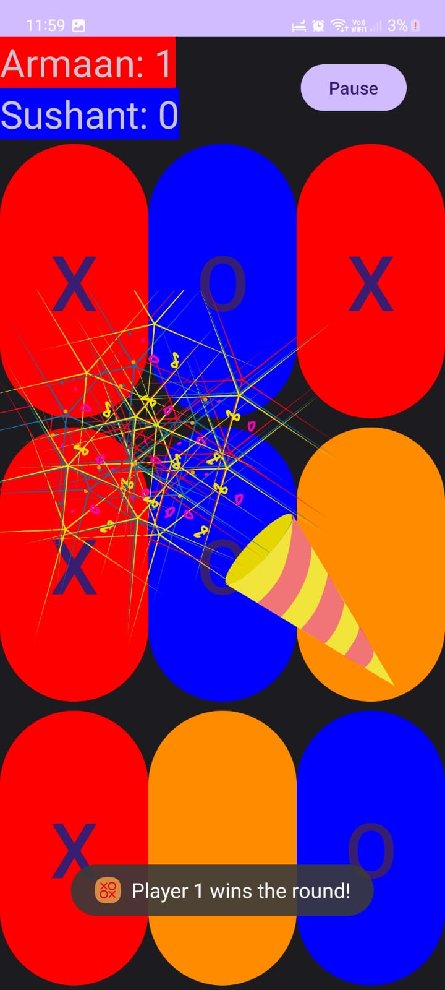
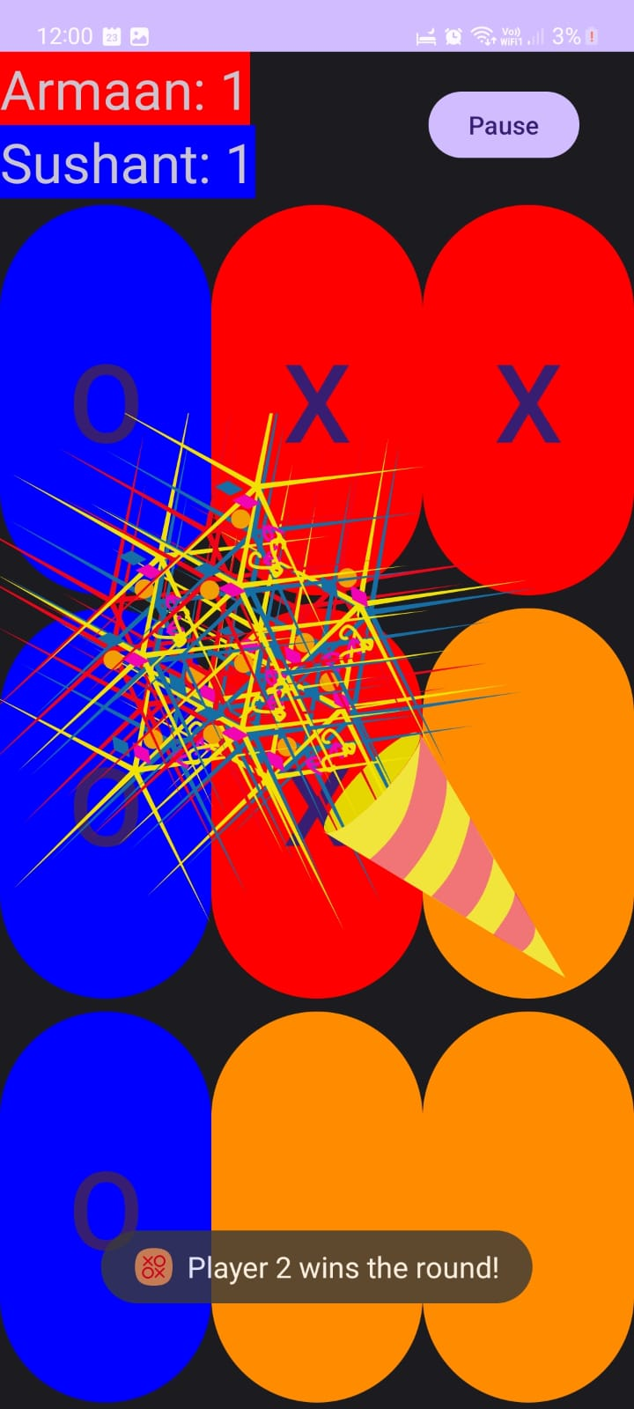
Winning Animations in 2 player mode:
Figure 11- Shows the animation and the toast that is displayed to the user when Player 1 wins the round.
Figure 12- Shows the animation and the toast that is displayed to the user when Player 2 wins the round.
Figure 12
Figure 11

Slide 24
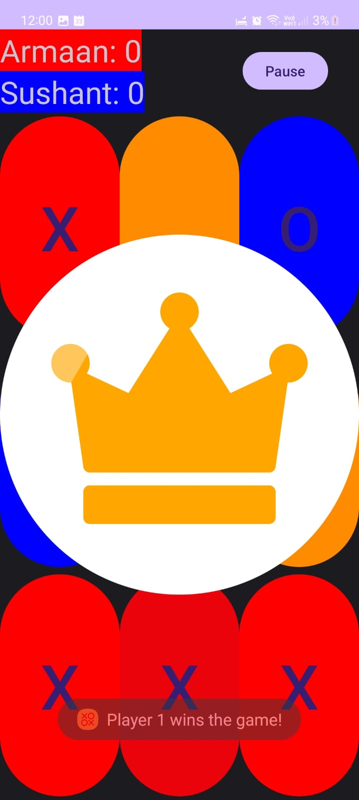
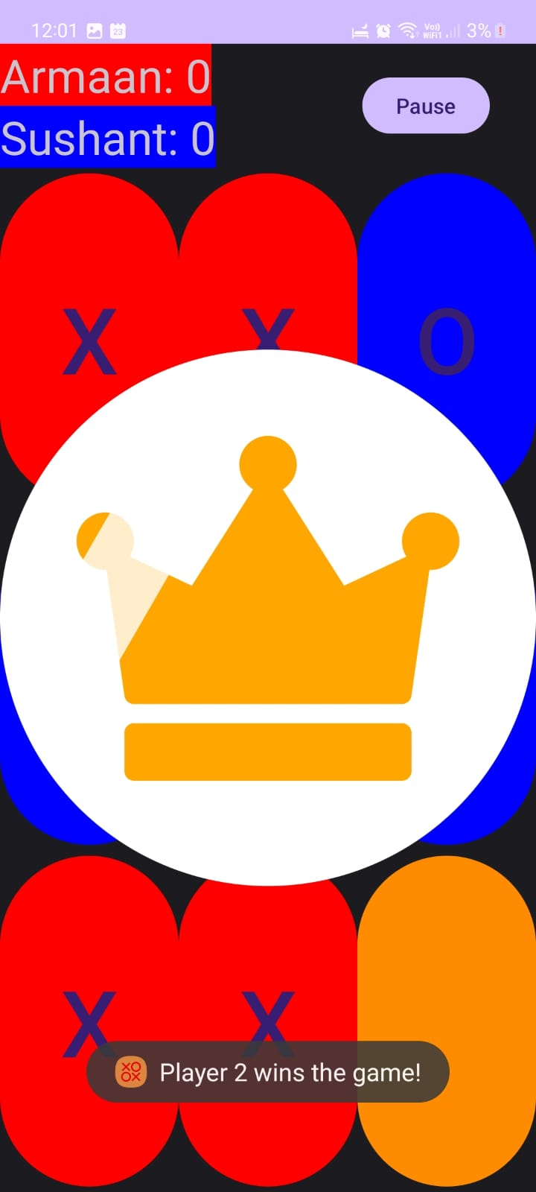
Figure 13- Shows the animation and the toast that is displayed to the user when player 1 wins the game.
Figure 14- Shows the animation and toast that is displayed to the user when player 2 wins the game.
Figure 14
Figure 13

Slide 25
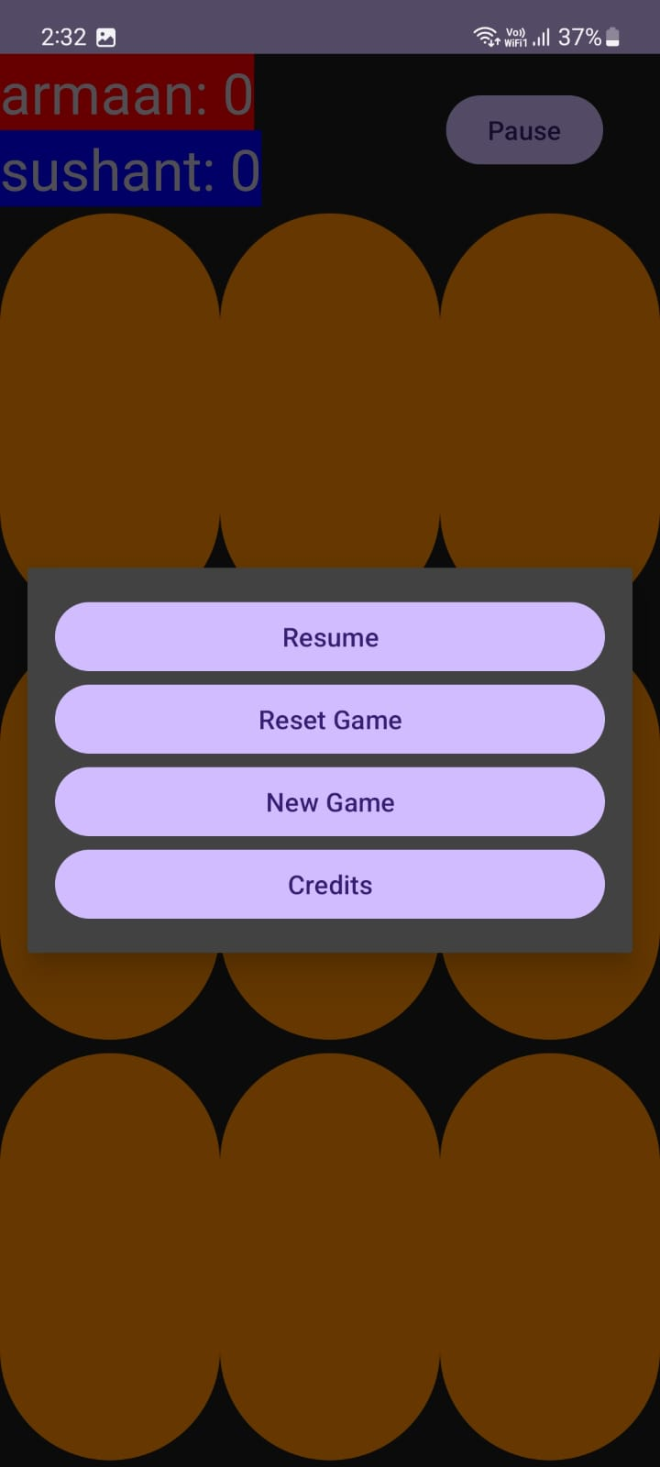
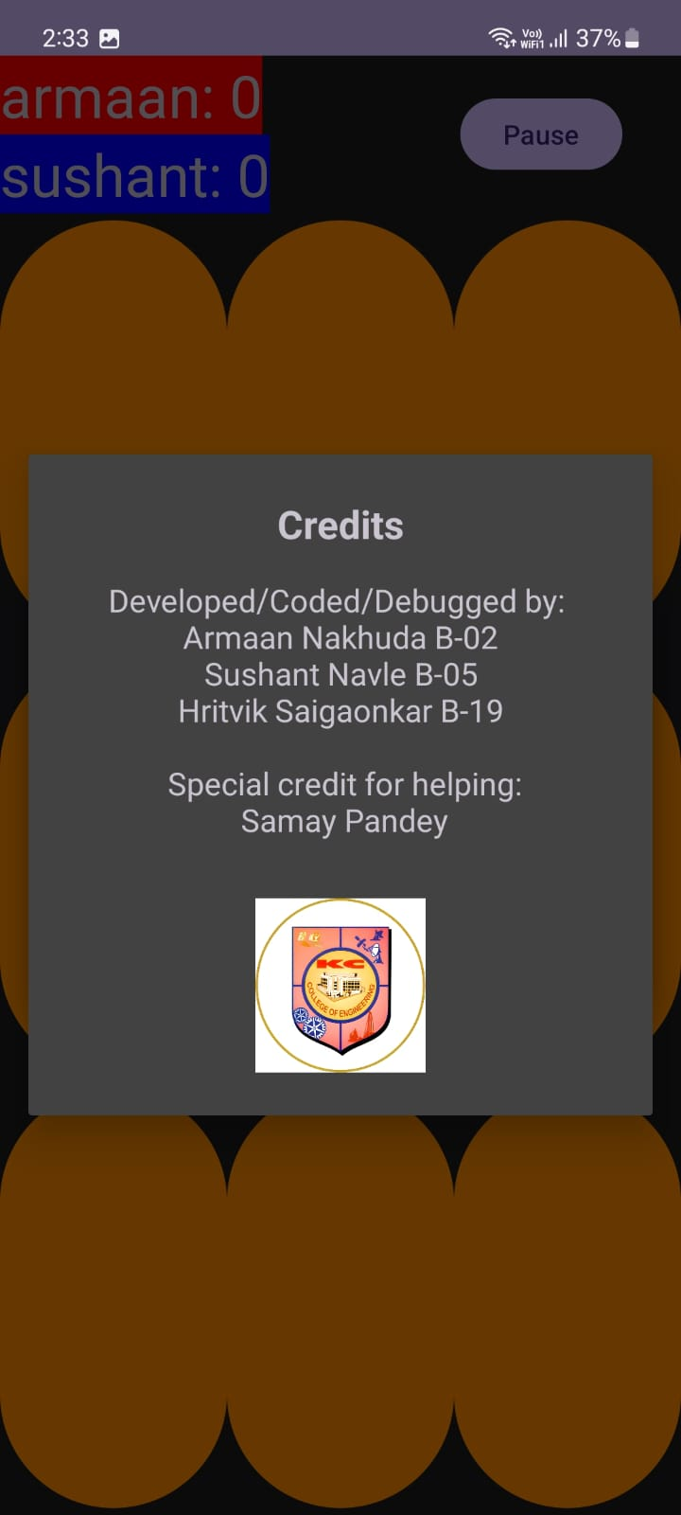
Pause Menu and Credits Dialogue:-
Figure 15 shows the pause menu that shows when the user clicks on the pause button, while Figure 16 shows the credits dialogue that can be accessed from the game startup screen and the pause menu.
Figure 15
Figure 16

Slide 26
References
References:
ChatGPT (OpenAI):
Useful for resolving technical issues and bug fixes during the project development process.
Website: OpenAI
GeeksforGeeks:
A valuable resource for generating ideas, solutions to coding challenges, and technical insights.
Website: GeeksforGeeks
YouTube:
A platform to explore a wide range of video tutorials, demonstrations, and insights related to mobile game development and user interface design.
Website: YouTube
The Github Repository of this Project with the Source code, Project Report and a copy of this PPT can be found at:
https://github.com/Armaan4477/TicTacToe

Slide 27
Thank You!!!

